Slide 1

Blockchain
Sunitha R
Department of Computer Science and Engineering

Slide 2

Blockchain
BLOCKCHAIN ON CIA SECURITY TRIAD
Sunitha R
Department of Computer Science and Engineering

Slide 3
Blockchain
Blockchain on the CIA Security Triad
Confidentiality, Integrity, and Availability (CIA) security triad model is one of the oldest and most popular security frameworks connected with the blockchain structure. The CIA triad model is a model that helps organizations structures their security posture.

Slide 4
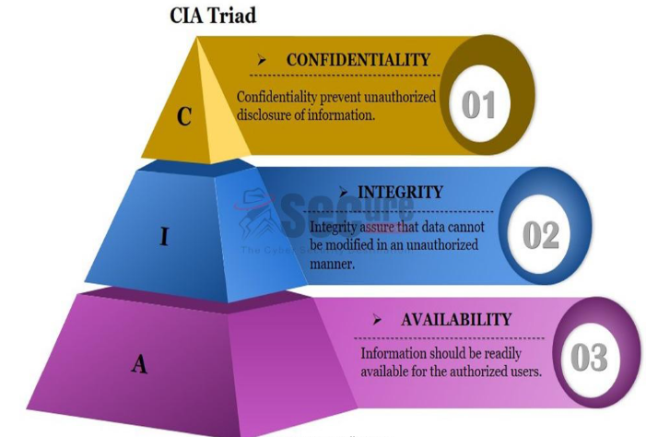
Blockchain
Blockchain on the CIA Security Triad

Slide 5
Blockchain
Confidentiality
Confidentiality is a way to keep information hidden from unauthorized people. In this current time of digital connectivity, everyone is aggressive enough to know that information that has been kept a secret.
Security agencies are a prime example of a company breaking confidentiality so that they can perform forensics and use surveillance footage. Financially motivated cyber criminals do their best to break into security systems and gather confidential documents that will benefit their business adversaries.

Slide 6
Blockchain
Integrity
Integrity is a way to protect the unauthorized tampering of information. It is a mandatory compliance for every infosec body. It is also a method to maintain the consistency, accuracy, and trustworthiness of the respective data over its entire life cycle.
There has to be complete security of the data, and any unauthorized access to it should be prohibited. Certain measures that aid these aforementioned things include file permission and user access controls.

Slide 7
Blockchain
Availability
Availability refers to on-time and reliable access to data. The path of going from data to information and information to value means that the value will be illegitimate if the information is not available at the right time.
Distributed denial-of-service (DDoS) and ransomware attacks are some of the most powerful weapons in the hands of malicious actors, and they use these attacks to keep information away from people who have authorized and legitimate access.
Organizations make several attempts to combat these attacks, including web application firewalls, DDoS protection, content delivery network (CDN), and even disaster recovery.

Slide 8
Blockchain
Confidentiality in the existing model
As we already know, blockchain technology was never made to be restrictive in nature, as anyone with client software can participate in the block generation process, or mining, in the case of Bitcoin.
Confidentiality with respect to the blockchain is simply about hiding transaction information from unwanted participants in the network. However, because of the open and Permissionless nature of the public blockchain such as Bitcoin, achieving a better confidentiality rank can be extremely difficult.

Slide 9
Blockchain
Businesses, blockchain, and confidentiality
When it is about business, confidentiality becomes a critical pillar in the cyber security space to achieve better trust among customers and other stakeholders
When a business interacts with another business, it is not just about how much information to share, it is also about who should have access to which information under what conditions. While considering Hyperledger Fabric, IBM suggests that certain points should be kept in mind:
With each transaction, it is important to know whether a participant can see complete information, a part of it, or no information at all. It has to be mentioned under a smart contract.
If the regulator has been assigned, then they must confirm the extent of data accessed by the regulator.
It is important to understand the nature of your network—static or flexible—as confidentiality parameters may change in the future, based on new participant roles and needs.

Slide 10
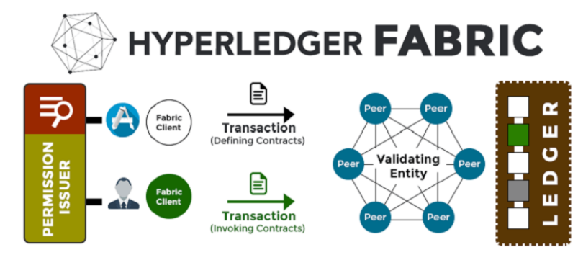
Blockchain
Achieving confidentiality with Hyperledger Fabric

Slide 11
Blockchain
Hyperledger Fabric
Hyperledger Fabric provides features to achieve confidentiality with the ease of calling a set of library files:
Attribute-based access control (ABAC)
Attribute Certificate Authority (ACA)
Hyperledger Fabric encryption literary

Slide 12
Blockchain
Supplementary readings
http://www.ijesi.org/papers/Vol(7)i1/Version-1/H0701015052.pdf
https://www.sciencedirect.com/science/article/abs/pii/S1467089518300794
https://arxiv.org/pdf/1903.07602.pdf

Slide 13
THANK YOU
Prof.Sunitha R
Department of Computer Science and Engineering
sunithar@pes.edu

